Slide 1


AI for VOCs detection
23/05/2024
Student: Maxime Wissocq
Supervisor: Romuald Jolivot

Slide 2
Table of contents
Personnal introduction
Introduction
Work progress
Conclusion

Slide 3
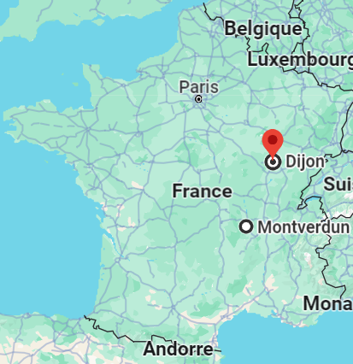
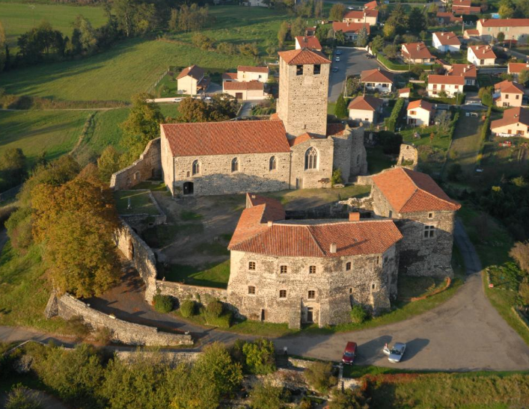
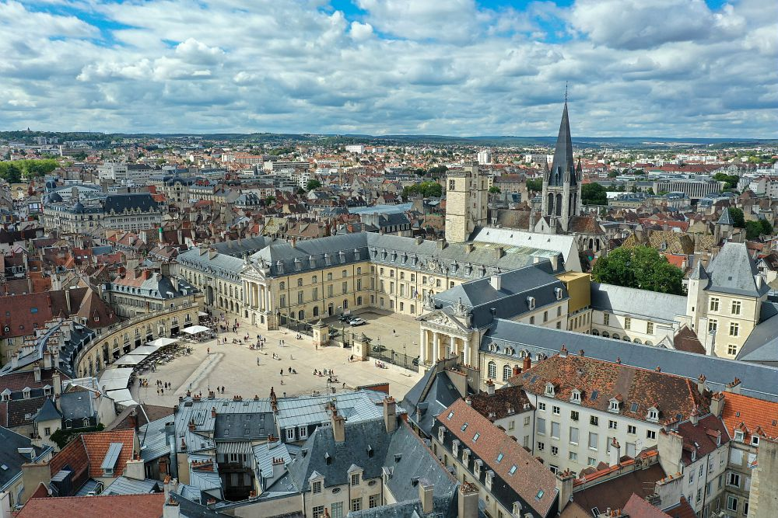
Personnal introduction
Position on the map
Montverdun
Dijon
https://www.gites-de-france-loire.com/
https://www.dijon-metropole.fr/

Slide 4

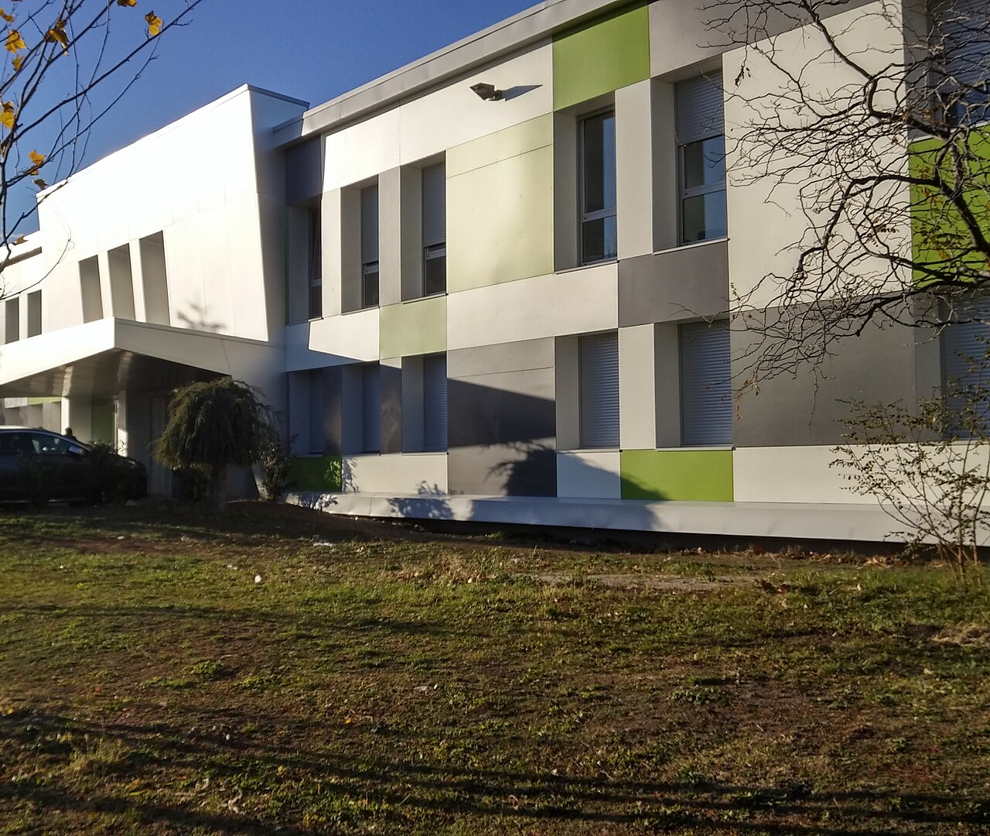
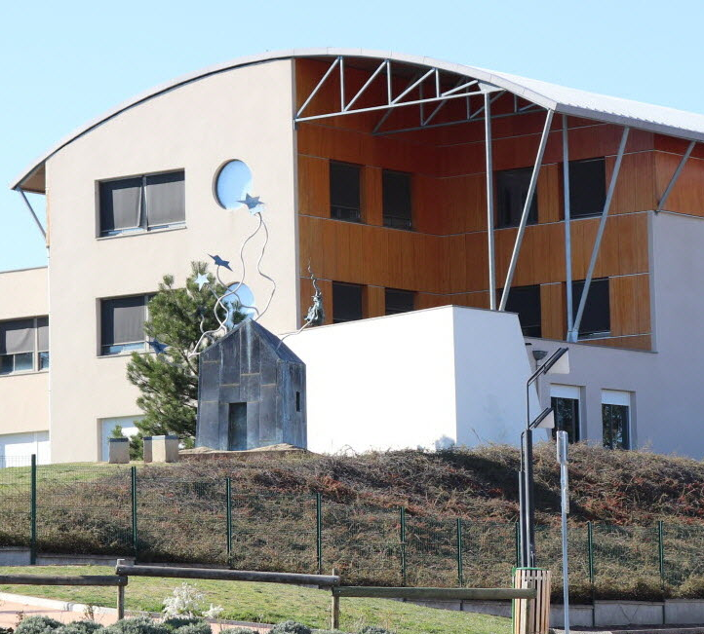
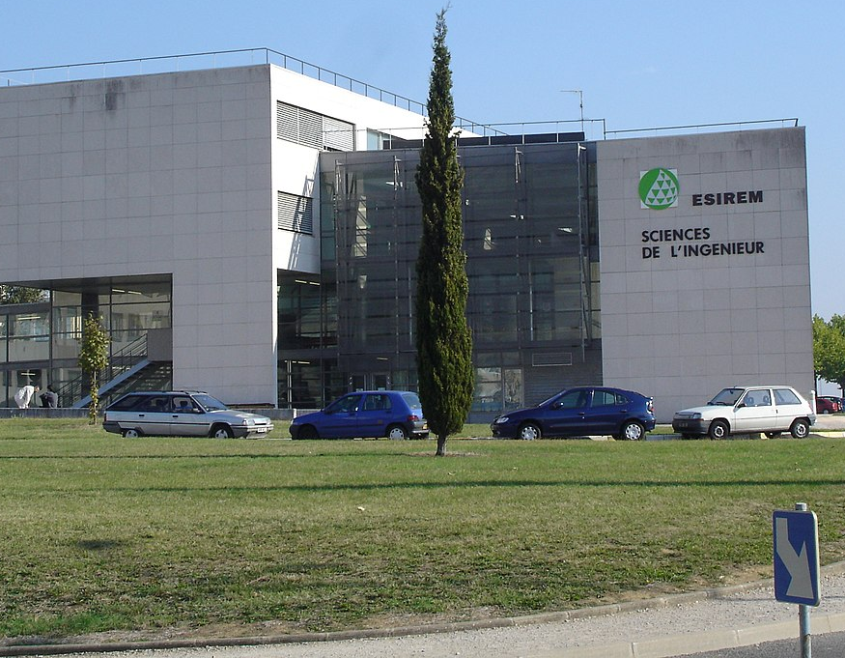
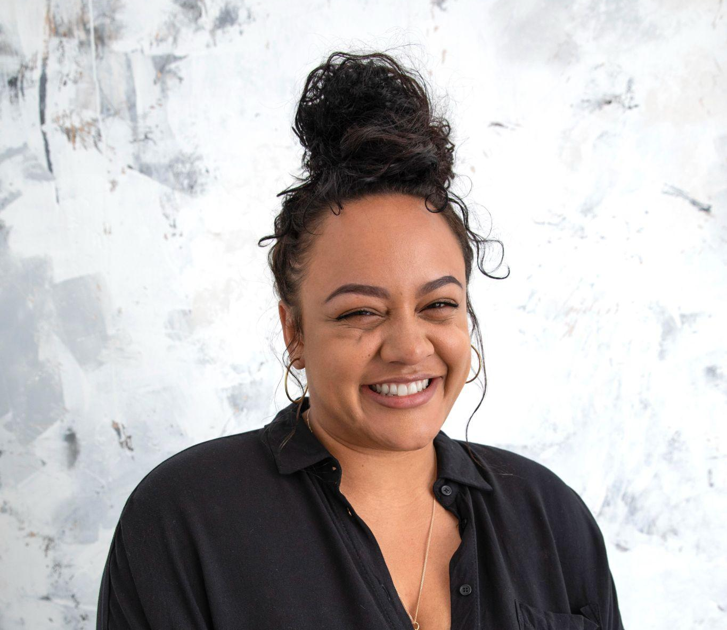
Educational path
Elementary school
First 2 years of College
Montverdun
IUT Clermont Auvergne
Middle/High school
Next 2 years of College
L’Astrée - Boën
Polytech Dijon

Slide 5




Volatile organic compounds
Presentation of the subject
Develop a system to quantify VOC using AI
Acquisition system

Slide 6

Presentation of the subject
Image/Signal processing
Sensor
Sensor data
https://datascientest.com/

Slide 7



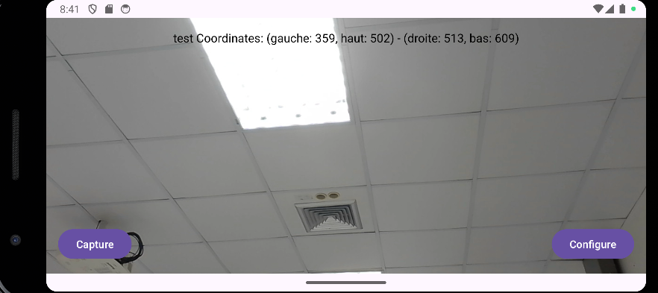
Technologies

Slide 8
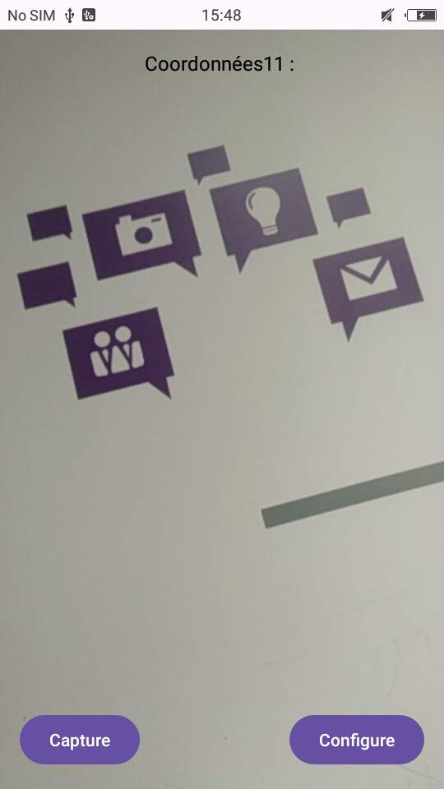
Feature #1: Image acquisition
Takes picture(s) on click
Set the number of pictures and the delay between each picture (timelapse)

Slide 9
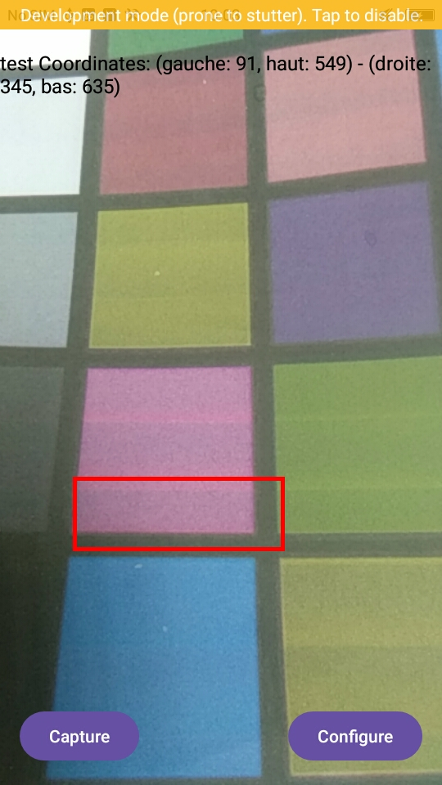
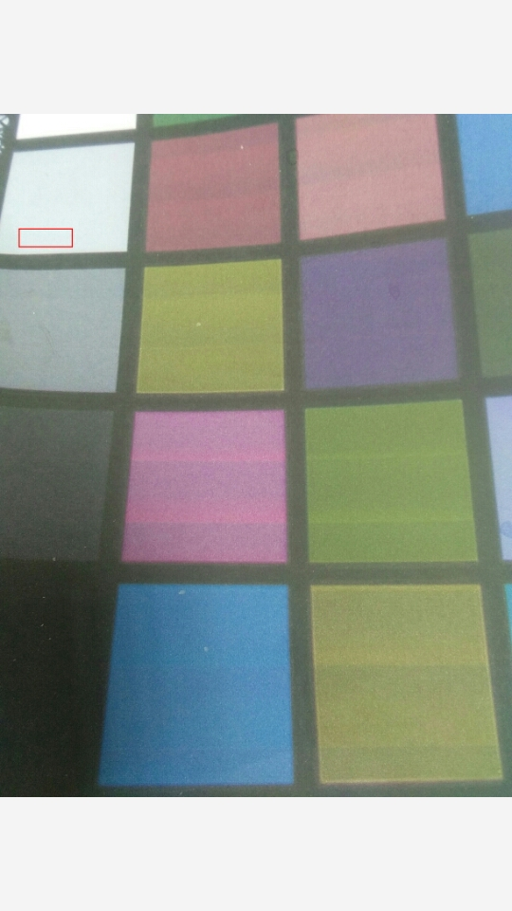
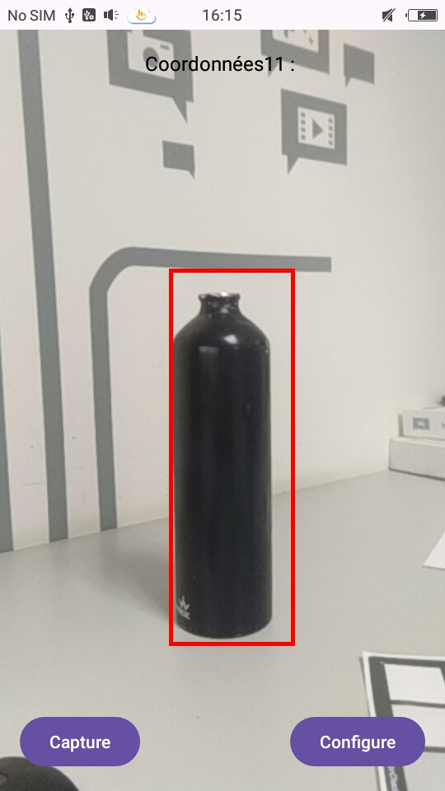

Feature #2: sensor detection and data extraction
Selecting the zone to crop
"Drawing" on the saved image
Offset!

Slide 10
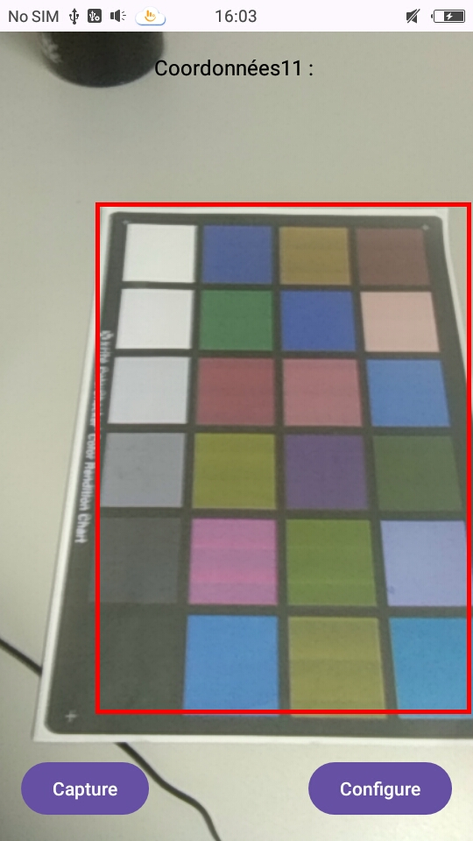
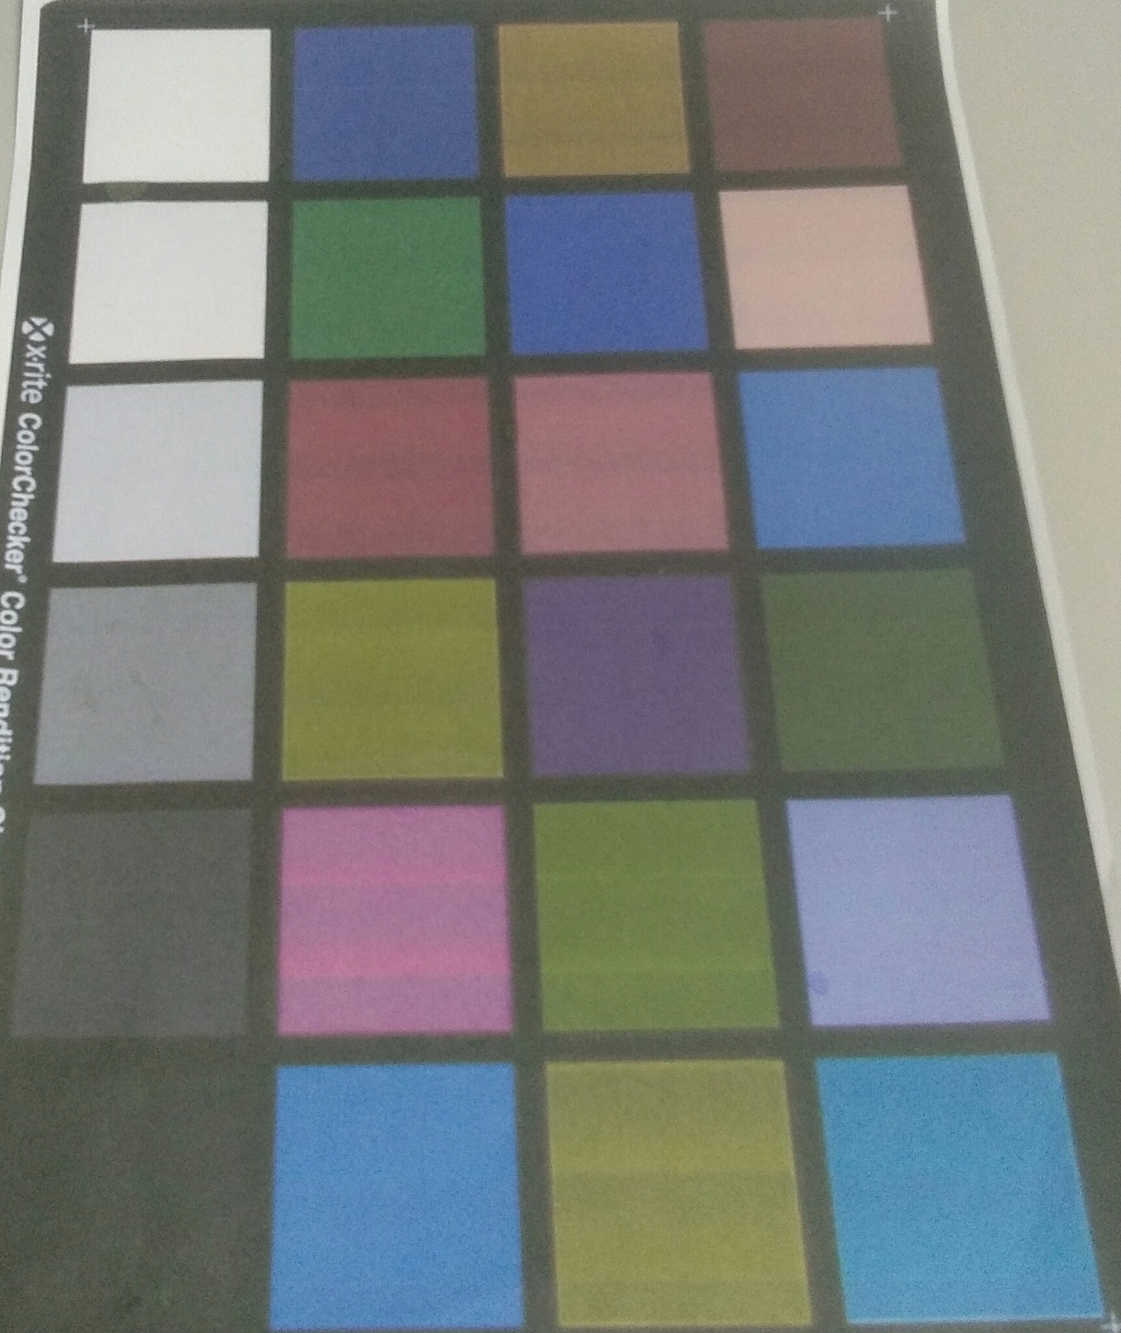
Feature #2: sensor detection and data extraction
Selecting the zone to crop
Cropped image

Slide 11
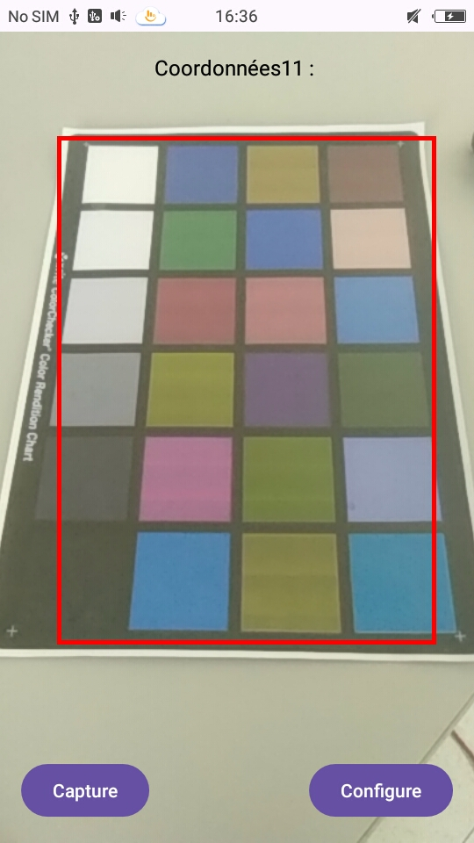
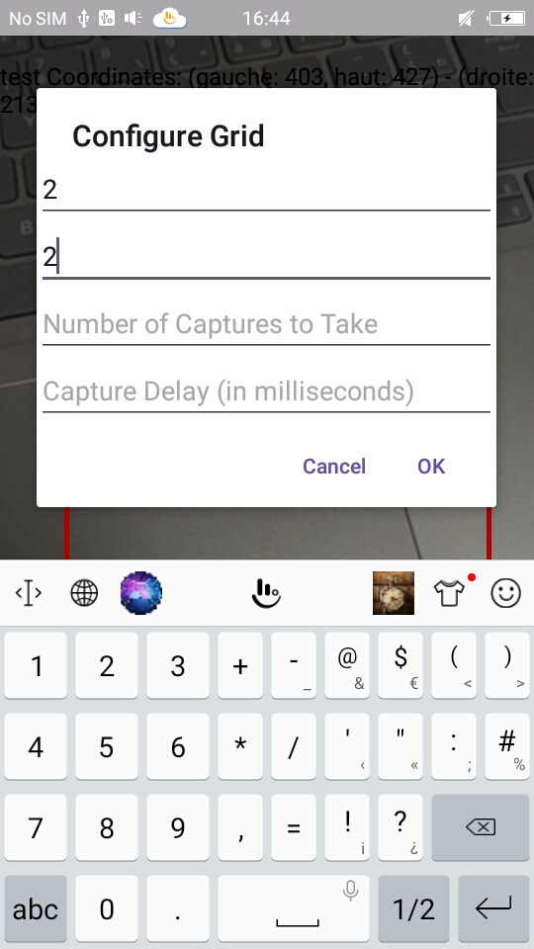
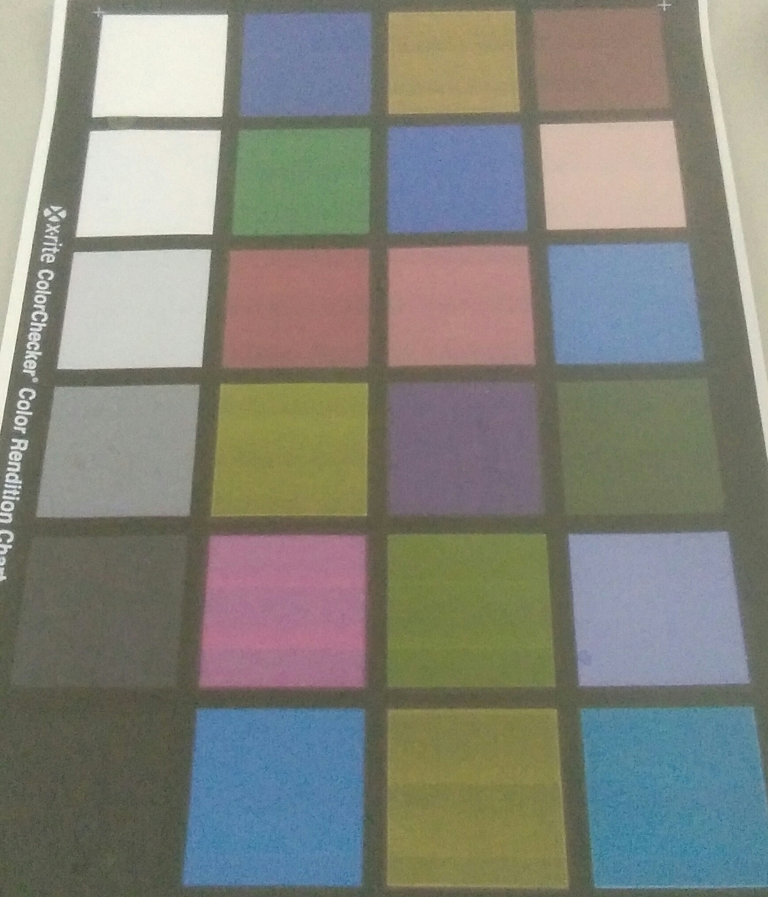
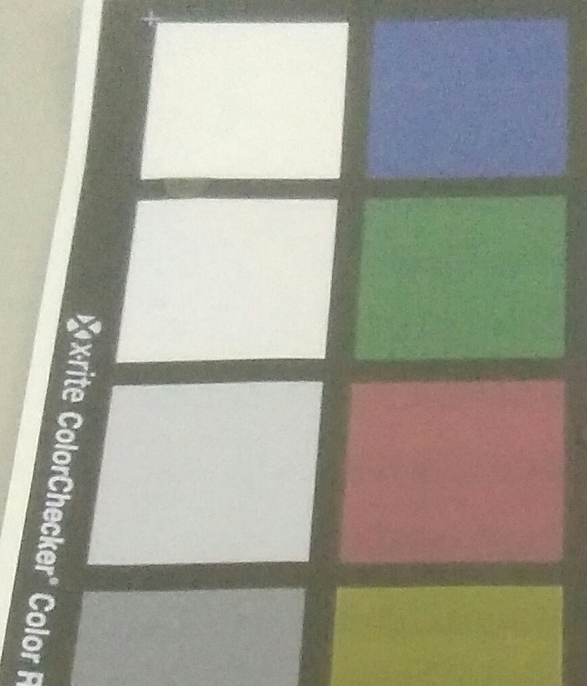
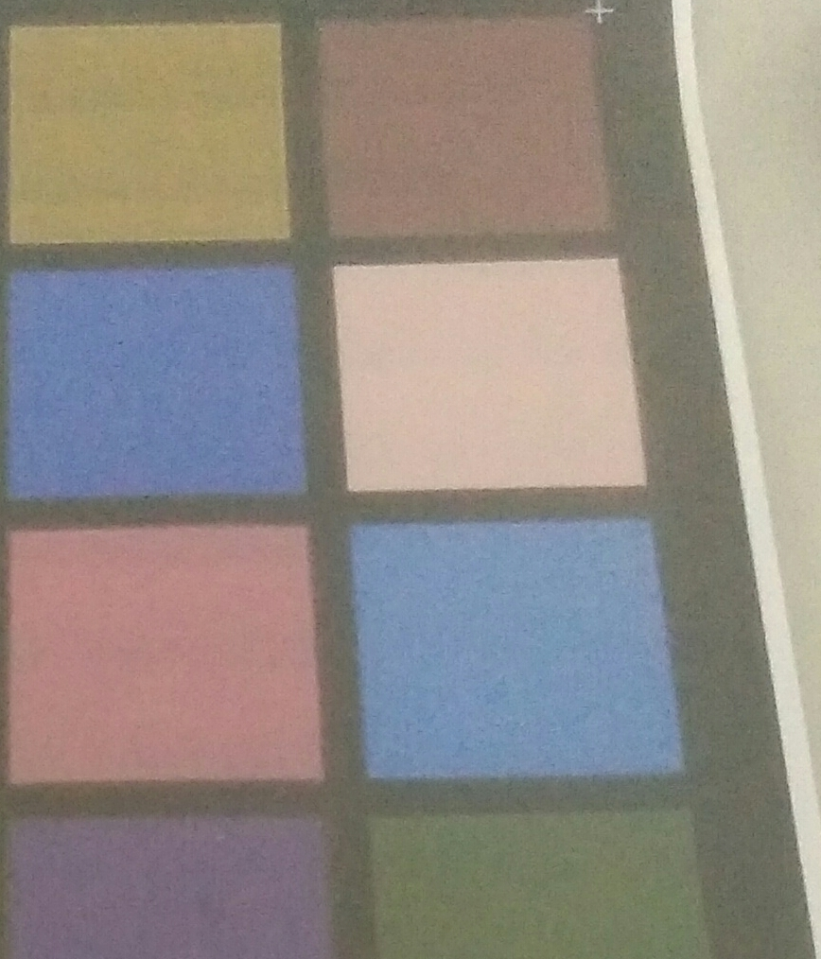
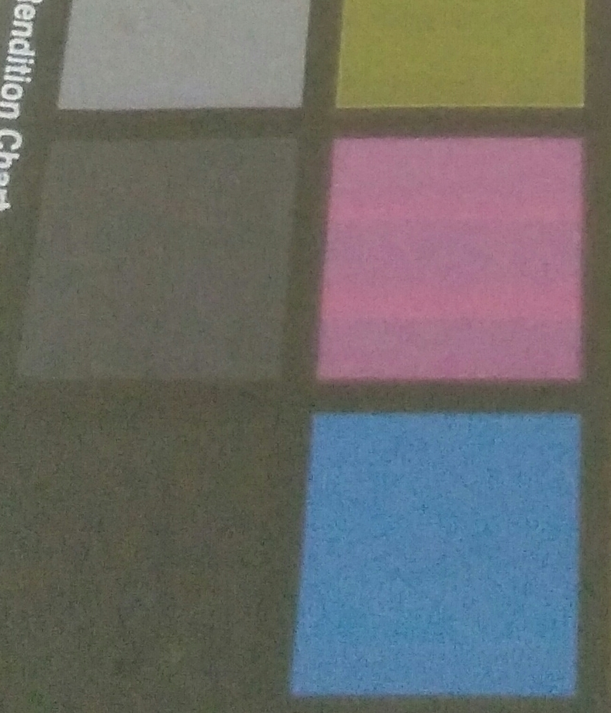
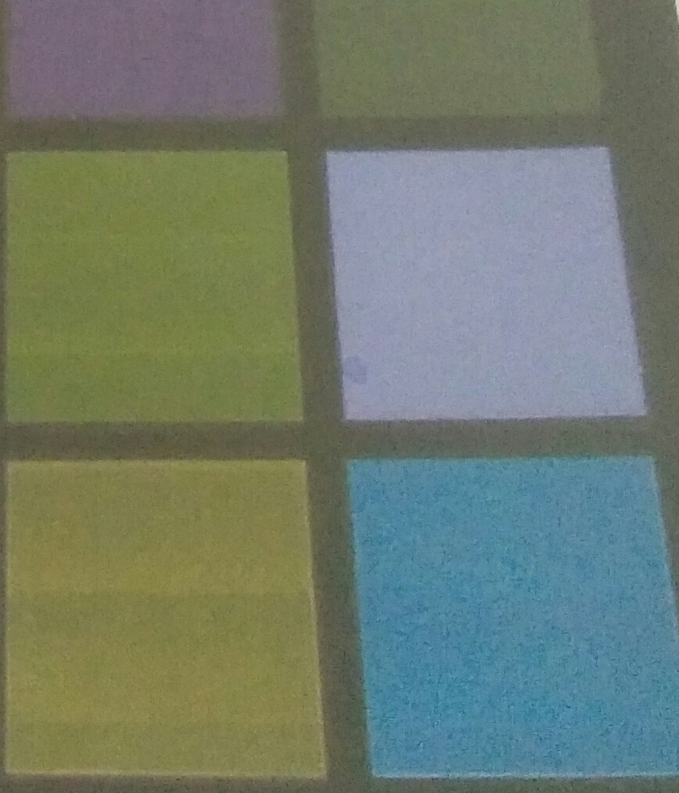
Feature #3: data extraction
The user can divide into a grid with 2 rows and 2 columns
The image was divided into 4 parts

Slide 12
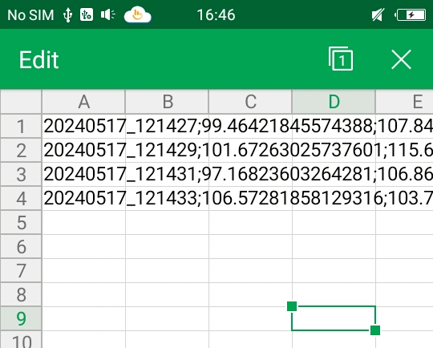
Feature #4: data recording
CSV file for 4 captures with a 2 seconds delay
Acquisition time
Average RBG values for each sensor extracted from the image

Slide 13
Conclusion
Developed an acquisition system
Implement a signal processing algorithm
Classification and detection

Slide 14
Thanks for listening

